Slide 1
Common Table Expressions
CTEs in Microsoft SQL Server

Slide 2
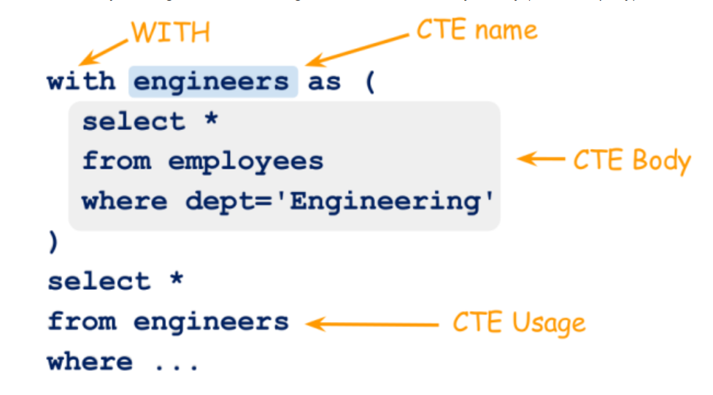
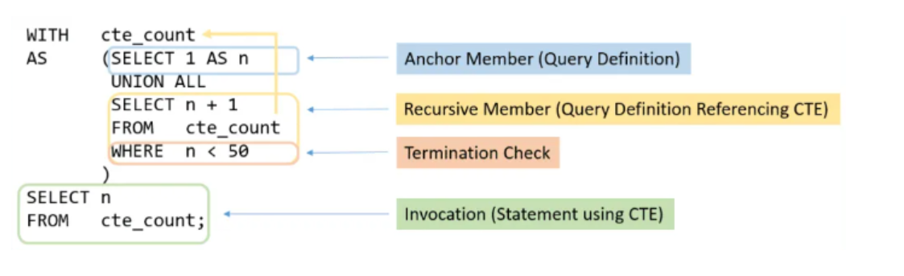
What is CTEs
A CTE allows you to define a temporary named result set that available temporarily in the execution scope of a statement such as SELECT, INSERT, UPDATE, DELETE, or MERGE.
Syntax
WITH expression_name [ ( column_name [,...n] ) ] AS ( CTE_query_definition )
Select [Column1,Column2,Column3 …..] from expression_name

Slide 3
Non-Recursive CTEs
Non-Recursive CTEs are simple where the CTE doesn’t use any recursion, or repeated processing in of a sub-routine.
-- Define the CTE expression name and column list.
WITH Sales_CTE (SalesPersonID, SalesOrderID, SalesYear) AS
-- Define the CTE query.
( SELECT SalesPersonID, SalesOrderID, YEAR(OrderDate) AS SalesYear FROM Sales.SalesOrderHeader WHERE SalesPersonID IS NOT NULL )
-- Define the outer query referencing the CTE name.
SELECT SalesPersonID, COUNT(SalesOrderID) AS TotalSales, SalesYear FROM Sales_CTE
GROUP BY SalesYear, SalesPersonID
ORDER BY SalesPersonID, SalesYear;

Slide 4
Recursive CTE
Recursive CTEs are use repeated procedural loops aka recursion. The recursive query call themselves until the query satisfied the condition.
WITH DirectReports(ManagerID, EmployeeID, Title, EmployeeLevel) AS
( SELECT ManagerID, EmployeeID, Title, 0 AS EmployeeLevel FROM dbo.MyEmployees
WHERE ManagerID IS NULL
UNION ALL
SELECT e.ManagerID, e.EmployeeID, e.Title, EmployeeLevel + 1 FROM dbo.MyEmployees AS e
INNER JOIN DirectReports AS d ON e.ManagerID = d.EmployeeID )
SELECT ManagerID, EmployeeID, Title, EmployeeLevel FROM DirectReports
ORDER BY ManagerID;
Source: WITH common_table_expression (Transact-SQL) - SQL Server | Microsoft Docs

